Slide 1
Mathematics Packs
Nursery 1 Nursery 2 Reception

Slide 2
In September 2012, the government made changes to the Early Years Foundation Stage Profile (EYFSP).
We use this document to measure the progress your child makes throughout their time in Nursery and Reception.
To support your child/ren at home, we are providing Mathematics resource packs. Regular practise at home will help to ensure your child/ren achieve the national expectations outlined in the EYFSP document.

Slide 3
What should my child be able to do by the end of Nursery?
Count to ten
Count objects to ten and beginning to count beyond ten
Select the correct number to represent objects to ten
Says the number that is one more or one less than a given number to ten
Knows the names of 2D shapes (e.g. circle, square, rectangle, triangle etc.)
Can use positional language (e.g. in front, behind, under, over etc.)
Show an understanding of length/height (e.g. taller, shorter etc.)
Show an understanding of weight (e.g. heavy, light etc.)
Show an understanding of capacity (e.g. empty, full etc.)
Uses everyday language relating to time (e.g. yesterday, today, tomorrow, later, before, soon, next etc.)
Begin to use everyday language in relation to money (e.g. pennies, pence, pounds)

Slide 4
What should my child be able to do by the end of Reception?
Count reliably from numbers 1-20
Place these numbers in order
Say which number is one more or less than the given number
Using quantities and objects, they add and subtract to single digit numbers and count on or back to find the answer
They solve problems including doubling, halving and sharing
Use everyday language to talk about size, weight, capacity, position, distance, time and money to compare quantities and objects and to solve problems
They recognise, create and describe patterns (e.g. repeating patterns – red, blue,
red, blue etc.)
They explore characteristics of everyday objects and shapes and use mathematical
language to describe them.

Slide 5
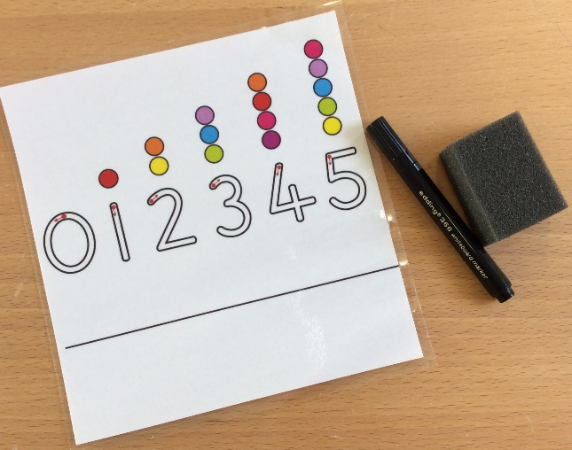
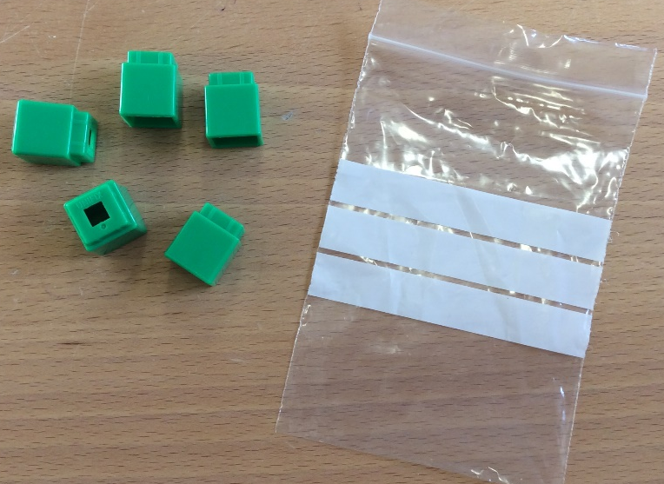
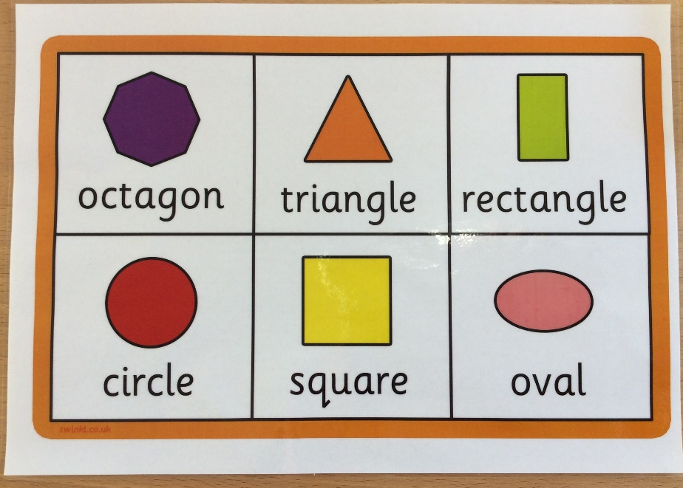
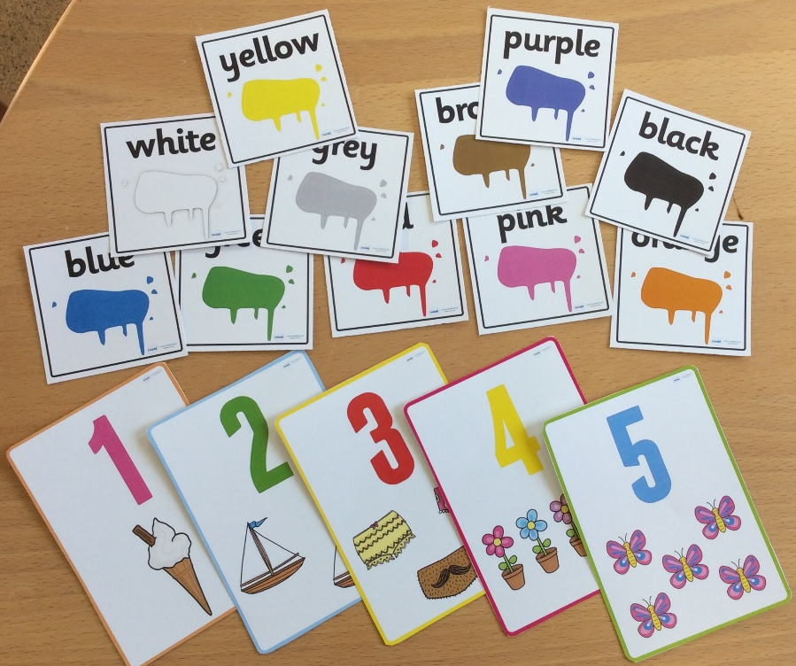
Nursery 1 Contents of Mathematics Pack

Slide 6
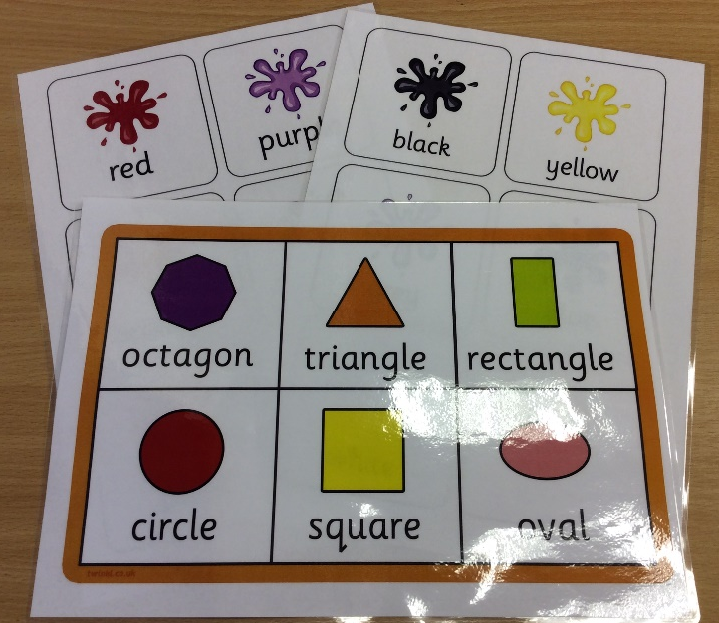
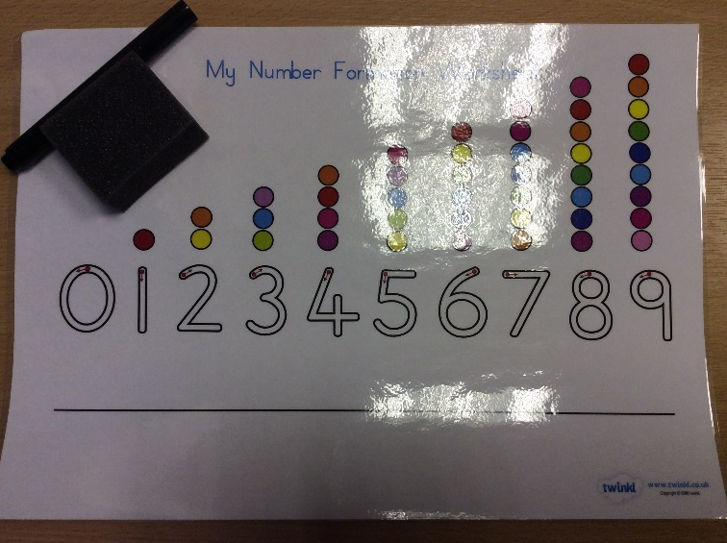
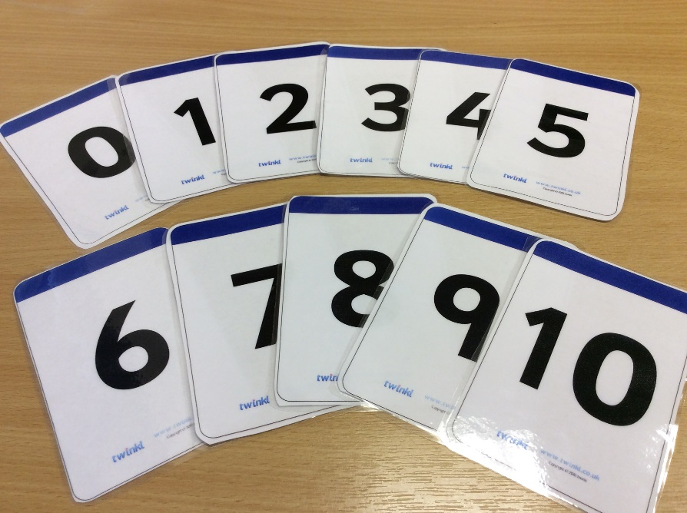
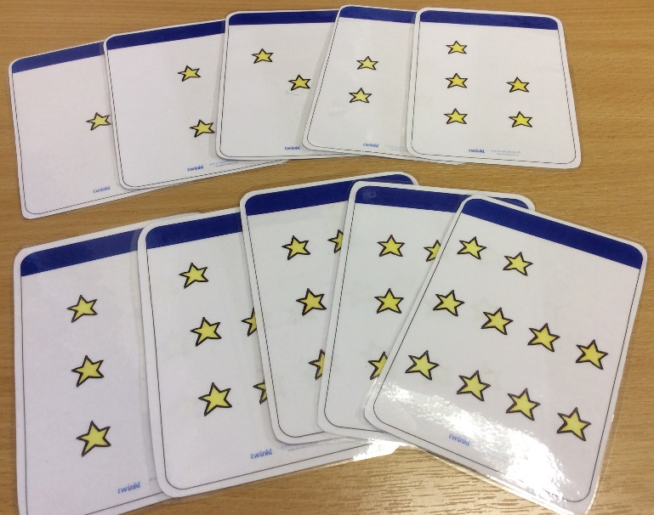
Nursery 2 Contents of Mathematics Pack

Slide 7
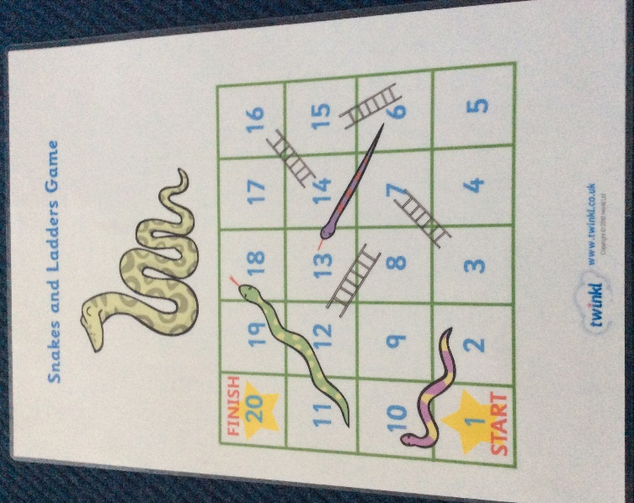
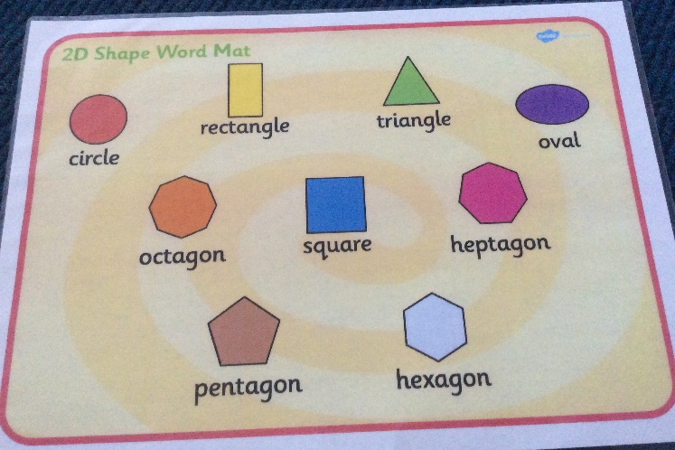
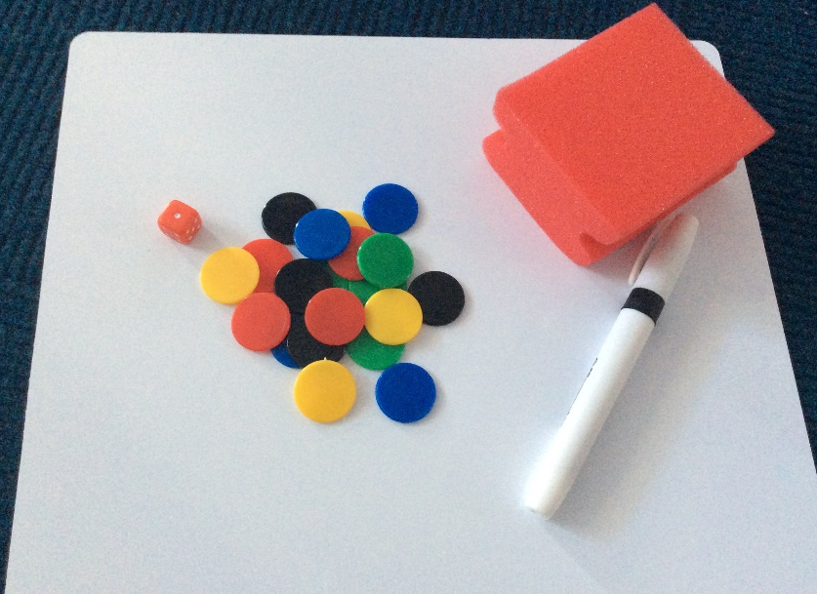
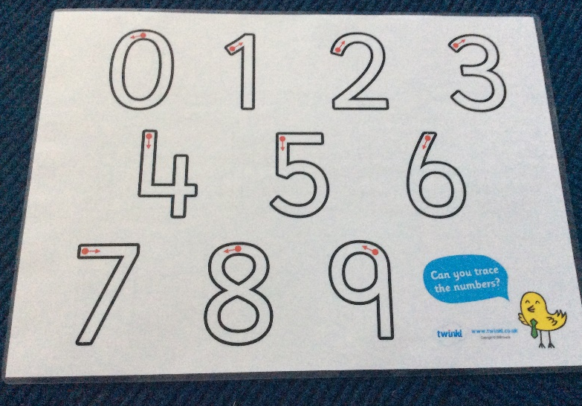
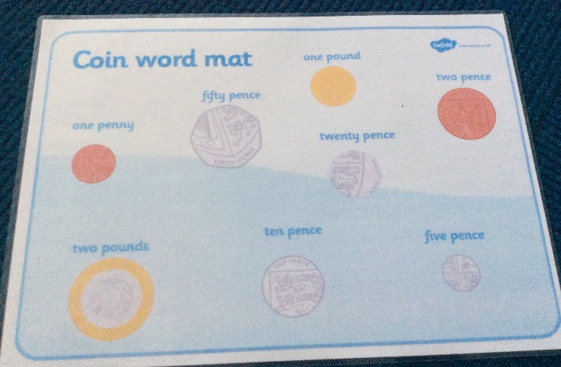
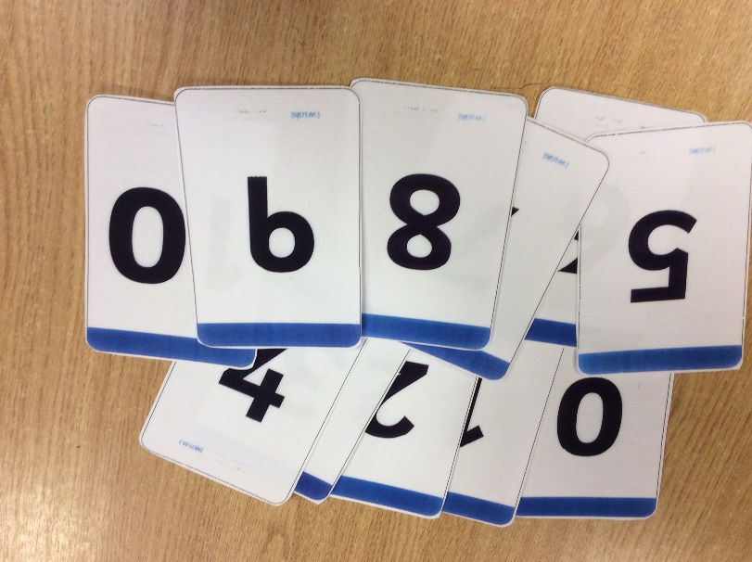
Reception Contents of Mathematics Pack

Slide 8
Thank you for your continued support. We hope you and your child/ren enjoy using the new resource.

